Slide 1
Regular expression

Slide 2
Regular Expression
Is a pattern that is composed of set of strings, which is to be matched to a particular textual content.
Allow handling of textual data effectively as it allows searching and replacing strings.
Allows handling of complex manipulation and validation, which could otherwise be implemented through lengthy scripts.

Slide 3
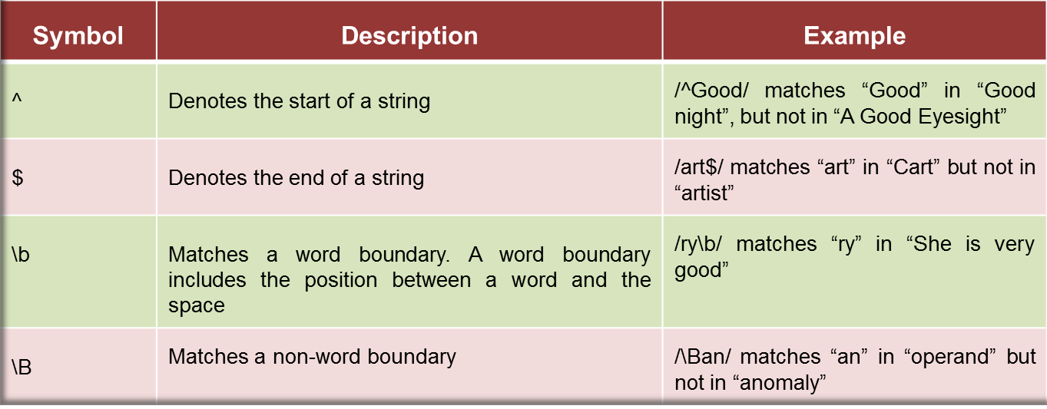
Position Matching
Characters or symbols in this category allow matching a substring that exists at a specific position within a string.

Slide 4
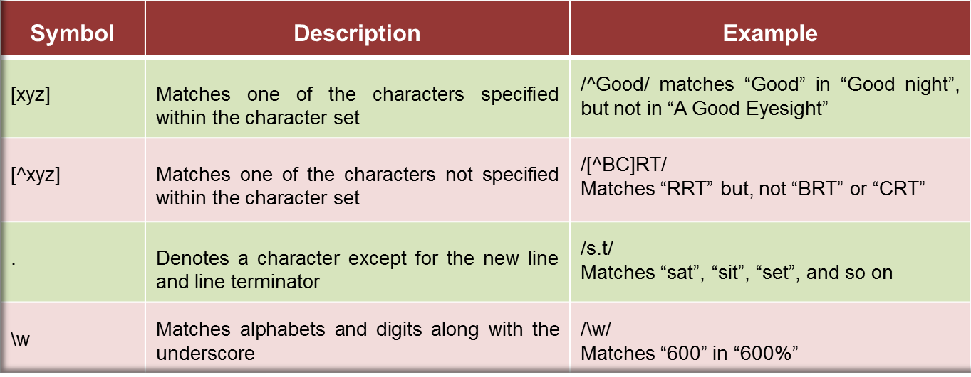
Character Classes
Characters or symbols in this category are combined to form character classes for specifying patterns
These classes are formed by placing a set of characters within the square brackets.

Slide 5
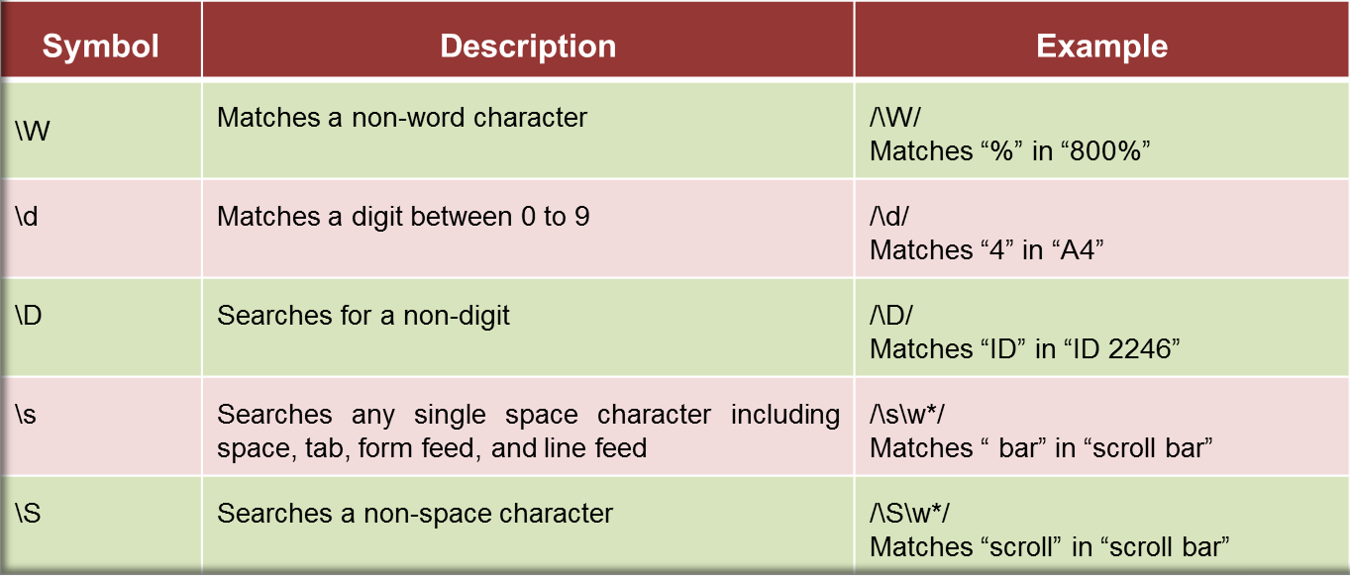

Slide 6
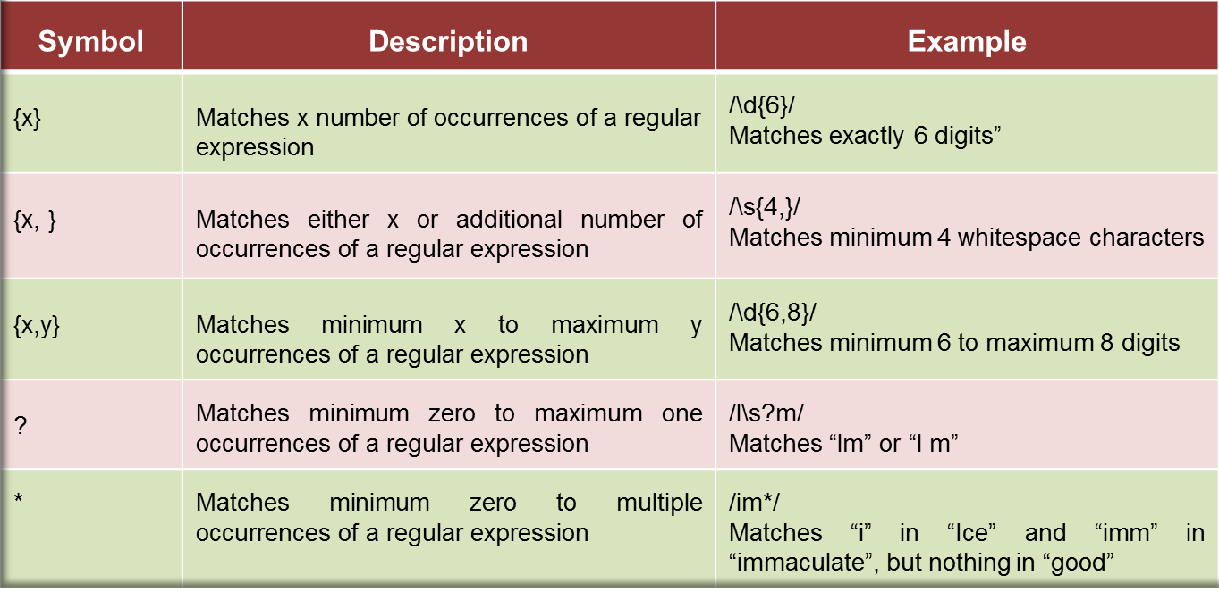
Repetition
Characters or symbols in this category allow matching characters that reappear frequently in a string.

